Slide 1
STUDENT RESULT MANAGEMENT SYSTEM
BENJAMIN NICOLAS S (22801005)
CHARLESS BINNY K (22801007)
MADHUMITHA G
(22801030)

Slide 2
ABSTRACT
The Student Result Management System is a secure, automated platform designed to streamline the management of academic records in educational institutions. It enables automated grade calculations, secure storage of student data, and real-time access to results for students and faculty. The system offers role-based access control, ensuring data privacy and compliance with regulations, while providing intuitive interfaces for users. Features like report generation, notice management, and scalability make it adaptable to institutional growth and evolving needs. By reducing manual effort, enhancing accuracy, and improving accessibility, the system addresses key challenges in traditional result management processes and modernizes academic administration.

Slide 3
INTRODUCTION AND OVERVIEW
In today's educational setting, the measurement of student performance is of utmost importance to educators and institutions. Traditionally, this has been done through manual processes, which are not only time-consuming but also prone to errors. However, the growing need to thoroughly analyze students' performances makes the development of automatic management systems imperative for improving the process and increasing the amount of data.
The Student Result Management System (SRMS) is a software solution designed to address this need. It is a system where academic management of records is made easy. It makes the process of collecting, analyzing, and processing student results convenient and easy for them. SRMS is the result of the automation of crucial tasks of grades and the computation of the results and report generation, which ultimately means the ensuring accuracy and saving time for the faculty.

Slide 4
EXISTING SYSTEM
Physical Records: There are still a few plants and institutions that use physical bound registers or logbooks as a storing mechanism for student information, attendance, and academic performance.
Basic Digital Tools: There are schools that have come to prefer digital technologies like spreadsheets (e.g., Microsoft Excel) or primitive database systems to the old ones in terms of managing academic records.
Result Compilation: The computations of the final score and overall average were made either manually or with basic formulas in the spreadsheets. It can slow down the learning process as well as increase the chances of mistakes, for instance in the case of large classes or multiple subjects

Slide 5
ADVANTAGES OF EXISTING SYSTEM
Minimal Financial Investment: The existing system typically involves minimal upfront costs, as it often relies on basic office supplies (e.g., registers, paper) or readily available software like Excel, which many institutions already have.
Simplicity: The existing system, especially when using physical records or simple spreadsheets, is straightforward and easy to implement without the need for complex software or IT infrastructure.
Accessibility Without Internet: Physical records and basic spreadsheets can be accessed and updated without an internet connection, making them usable even in areas with limited or unreliable internet access.

Slide 6
DISADVANTAGES OF EXISTING SYSTEM
Human Error: The manual entry and calculation processes are prone to mistakes, such as incorrect data entry, miscalculations, or loss of records. These errors can impact the accuracy of student results and reports.
Vulnerability to Loss or Damage: Physical records are susceptible to being lost, stolen, or damaged (e.g., through fire, water, or wear and tear). Basic digital files are also vulnerable if not backed up properly.
Lack of Backup and Recovery: In the event of an accident or disaster, there may be no effective way to recover lost data, leading to permanent loss of important academic records.

Slide 7
PROPOSED SYSTEM
The proposed Student Result Management System is a secure, automated platform designed to simplify and enhance the process of managing student grades and academic records. It includes features such as automated grade calculation, secure data storage with encryption, role-based access control, and real-time result access for students and faculty. The system streamlines report generation, enabling administrators to create accurate, comprehensive grade reports quickly. With a user-friendly interface, it ensures ease of use for all stakeholders, regardless of technical expertise. Scalable and adaptable, the system can accommodate growing institutional needs while maintaining efficiency, data security, and compliance with privacy standards.

Slide 8
ADVANTAGES OF PROPOSED SYSTEM
Increased Efficiency:The system automates the result processing and report generation, significantly reducing the time and effort required by administrative staff.
Improved Accuracy:Automated calculations and data entry minimize human errors, ensuring that student results are accurate and reliable.
Enhanced Data Security:Role-based access control and encryption protect sensitive student data, ensuring only authorized users can access or modify records.
Real-Time Access and Updates:Students, faculty, and administrators can access up-to-date results instantly, improving communication and transparency.
Scalability:The system is designed to grow with the institution, easily handling increases in student numbers and academic programs without significant changes..
User-Friendly Interface:The intuitive design ensures that all users, regardless of their technical skills, can easily navigate and use the system.

Slide 9
SYSTEM ARCHITECTURE AND MODULE DESCRIPTIONS

Slide 10
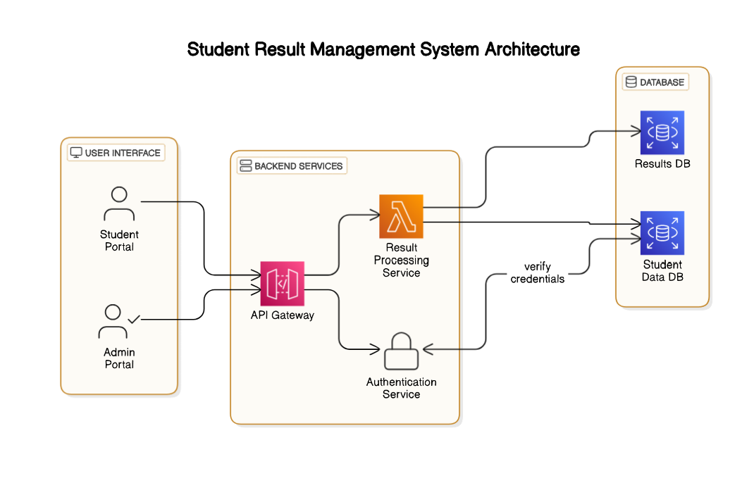
SYSTEM ARCHITECTURE

Slide 11
LIST OF MODULES
ADMIN
STUDENT
RESULT PROCESSING
NOTICE
DATABASE

Slide 12
MODULE 1: ADMIN
Manage user accounts by adding, editing, or removing students, teachers, and other administrators.
Assign roles and permissions to ensure role-based access control within the system.
Upload, update, and manage student data, including academic records and personal details.
Oversee result processing and approve or finalize grades submitted by teachers.
Generate, view, and distribute comprehensive grade reports for individuals or classes.
Monitor system usage and generate analytics on user activity, performance trends, and institutional metrics.
Manage data backup and restoration processes to ensure data integrity and recovery in case of failures.
Configure system settings, including grading schemes, assessment weightages, and academic calendar updates.
Ensure compliance with data security policies by managing encrypted storage and access logs.
Resolve user queries and troubleshoot issues related to system access or data discrepancies.

Slide 13
MODULE 2: STUDENT
Allow students to securely log in and access their academic records.
Enable students to view their grades and download result reports in real-time.
Provide options for students to update their personal details, such as contact information.
Allow students to track academic progress across different semesters or terms.
Facilitate communication with administrators or teachers regarding discrepancies in grades.

Slide 14
MODULE 3: RESULT PROCESSING
Automate grade calculation based on predefined criteria and weightages for assessments.
Validate and process raw scores submitted by teachers to ensure accuracy.
Generate cumulative grade point averages (CGPA) or final grades for each student.
Support adjustments for special cases, such as re-evaluations or grade corrections.
Integrate with the reporting module to generate detailed grade reports for individual students or entire classes.

Slide 15
MODULE 4: DATABASE
Store all student, teacher, and administrator data securely using encryption.
Maintain academic records, including grades, attendance, and personal details.
Ensure role-based data access to protect sensitive information.
Support backup and recovery mechanisms to prevent data loss during system failures.
Allow for efficient querying and retrieval of data for reports, analytics, or audits.

Slide 16
MODULE 5: NOTICE
Allow administrators to create and publish notices for students and staff.
Display announcements, such as result publication dates, important deadlines, or updates.
Provide role-based visibility, ensuring relevant notices reach the intended audience.
Archive old notices for future reference or documentation purposes.
Enable notifications through email or SMS for critical updates and reminders.

Slide 17
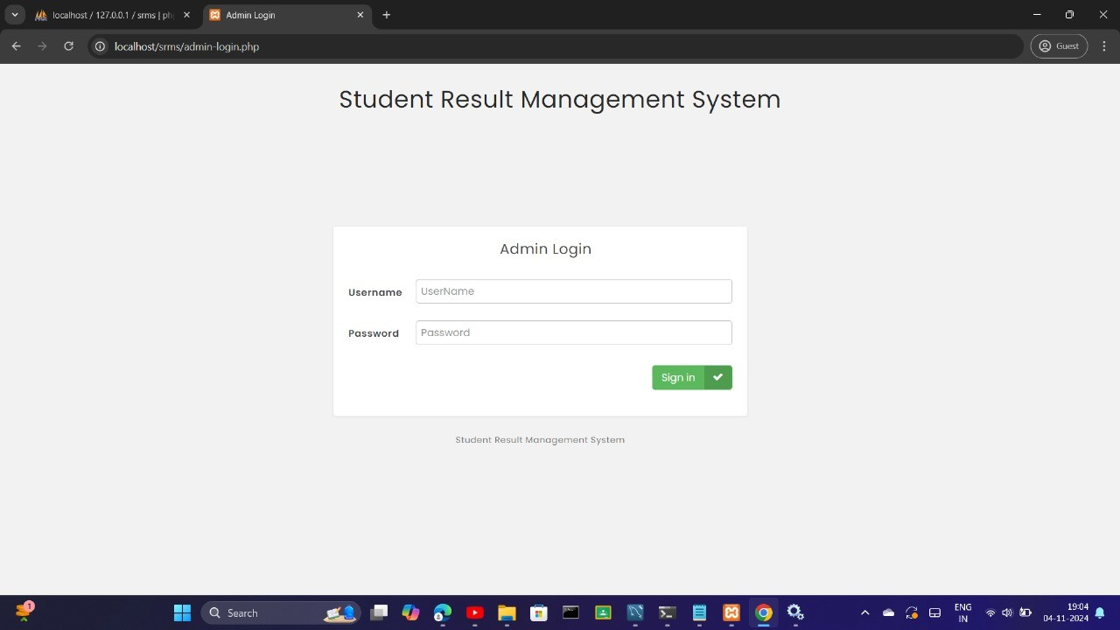
OUTPUT

Slide 18
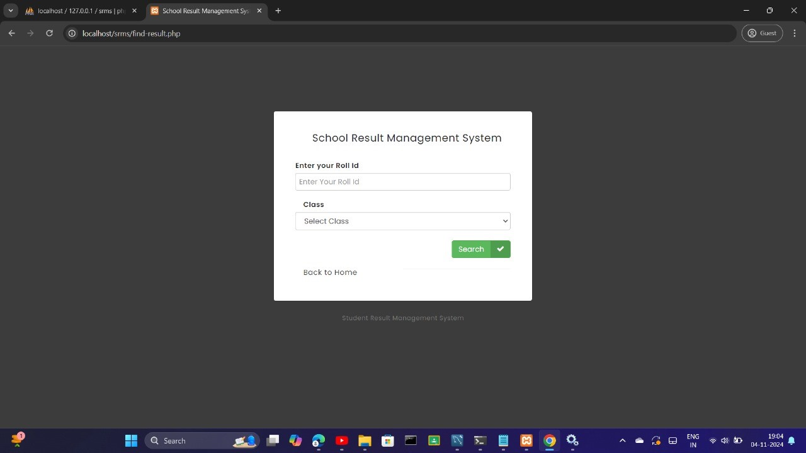
OUTPUT

Slide 19
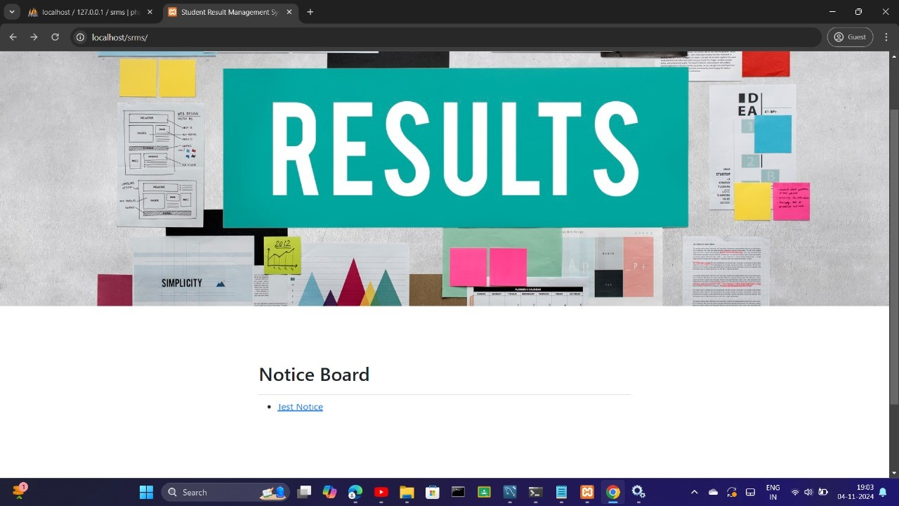
OUTPUT

Slide 20
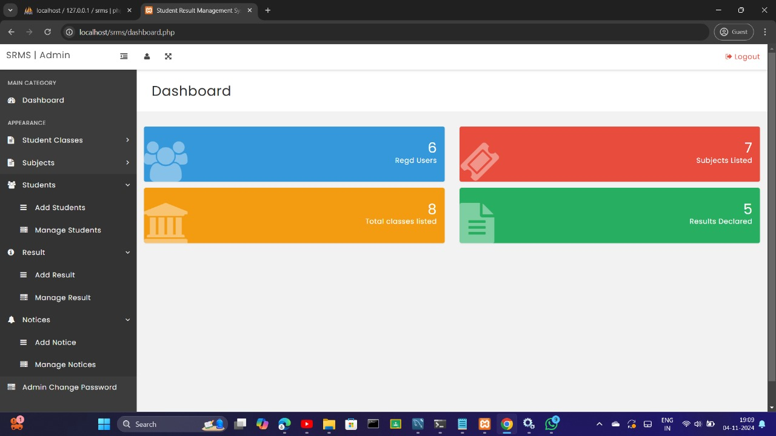
OUTPUT

Slide 21
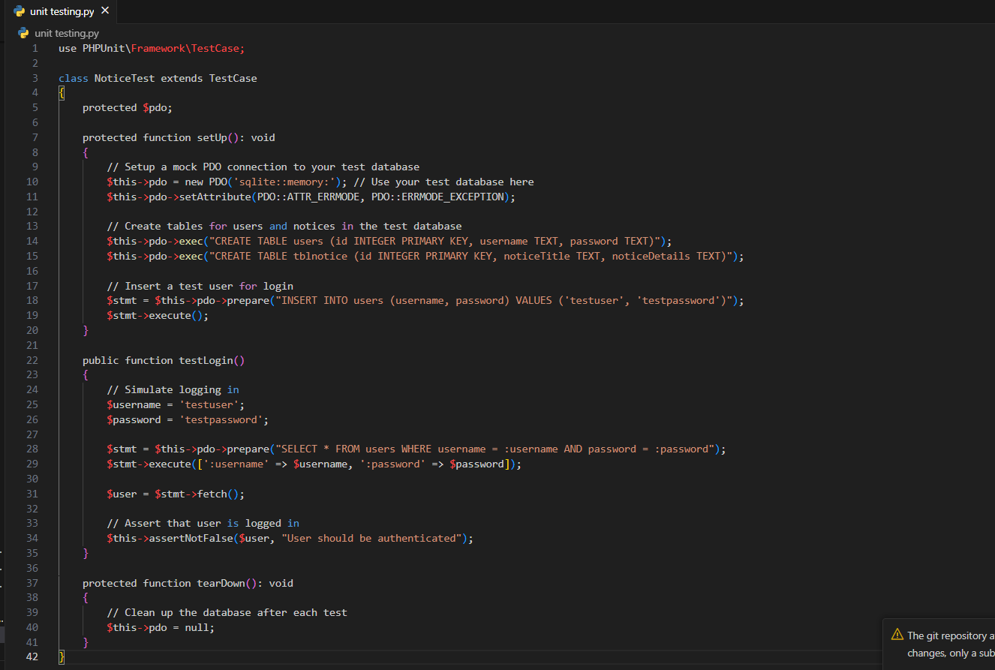
TEST OUTPUT

Slide 22
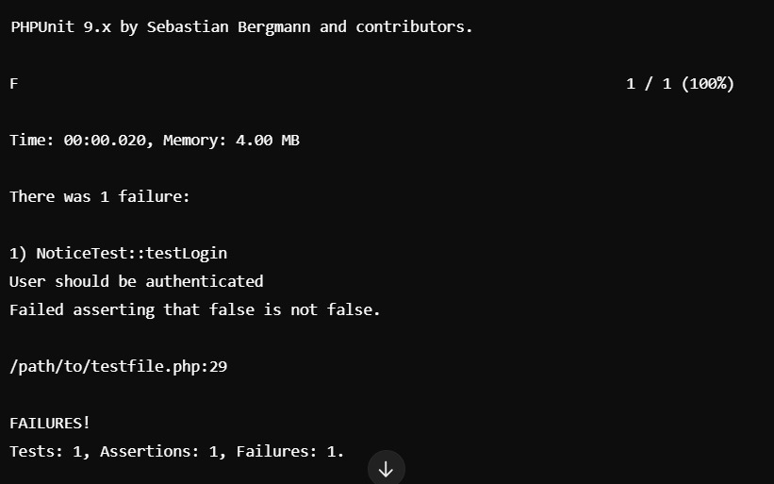
TEST OUTPUT

Slide 23
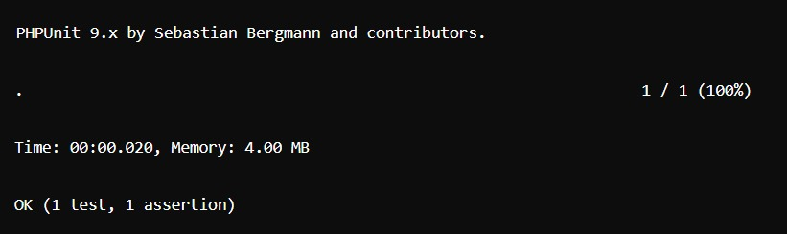
TEST OUTPUT

Slide 24
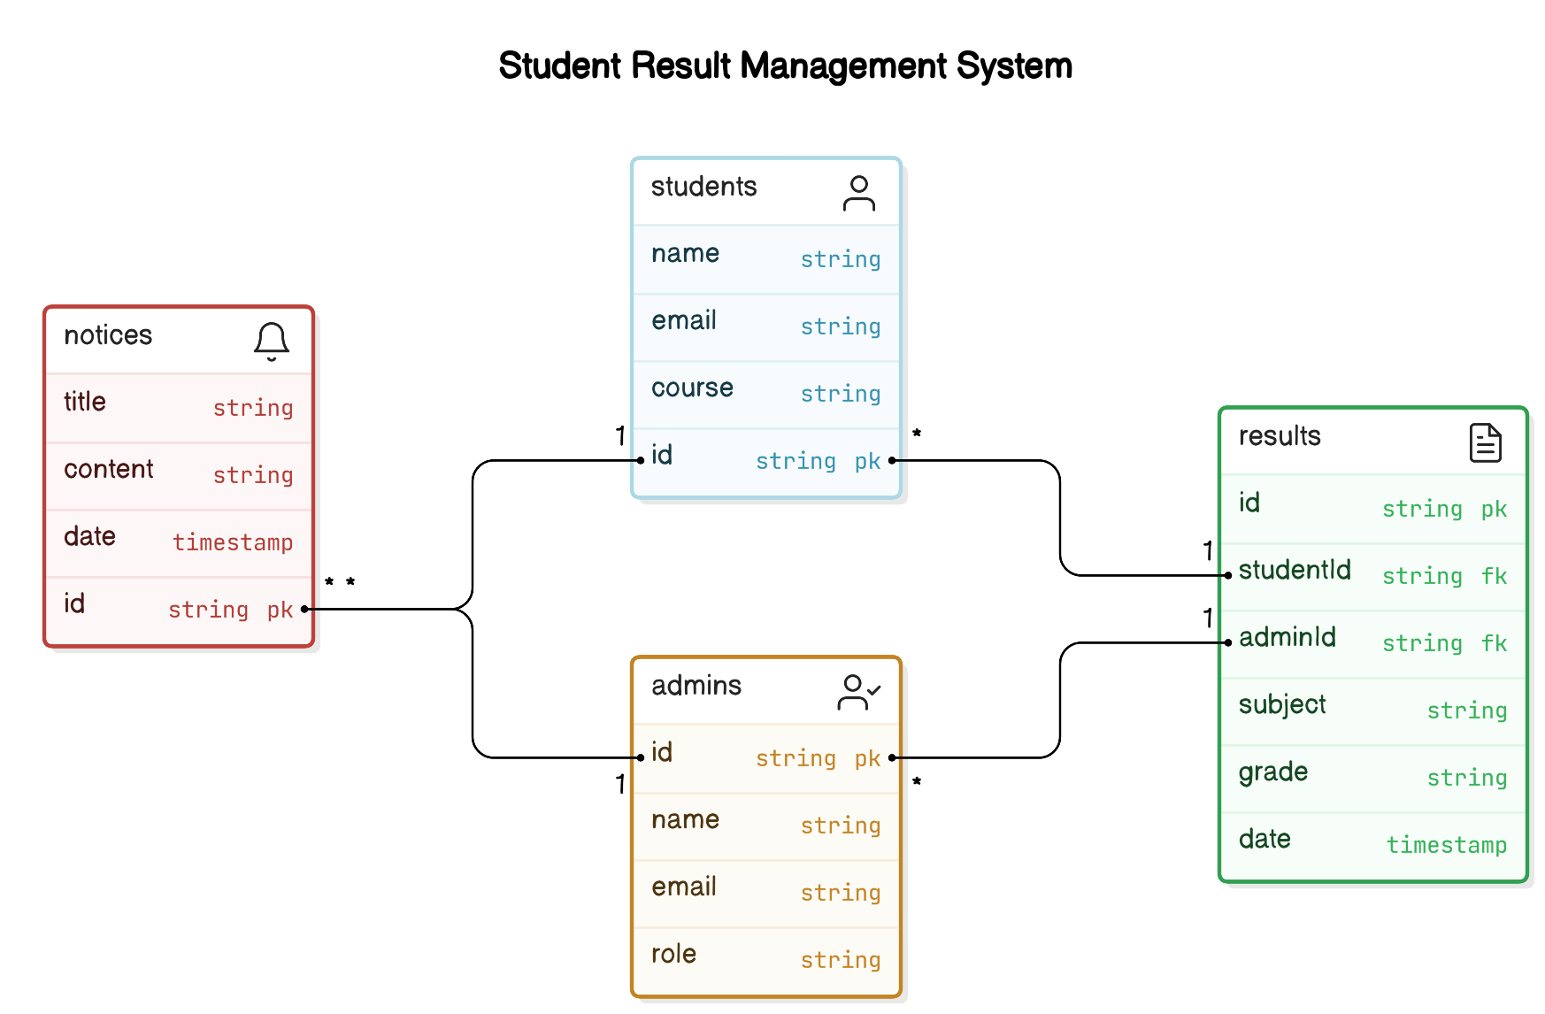
CLASS DIAGRAM

Slide 25
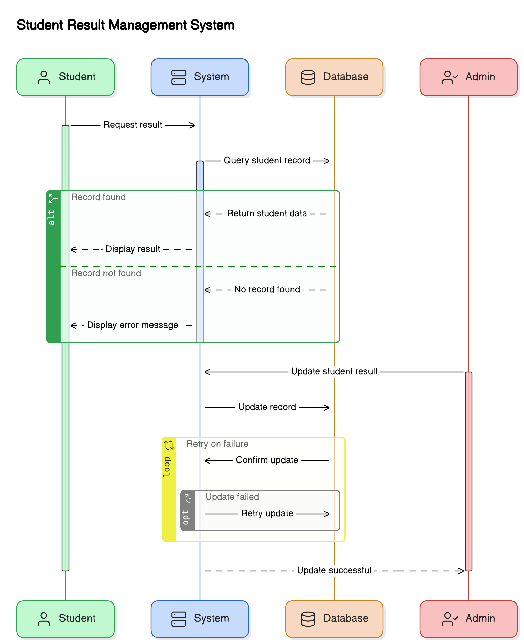
SEQUENCE DIAGRAM

Slide 26
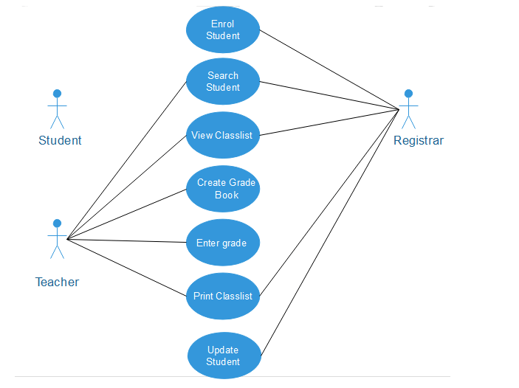
USE CASE DIAGRAM

Slide 27
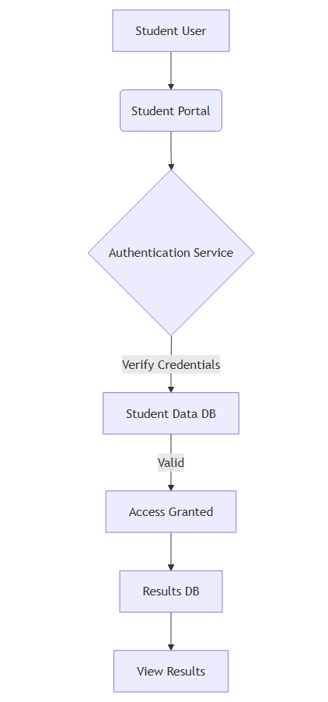
MODULE 1: DFD

Slide 28
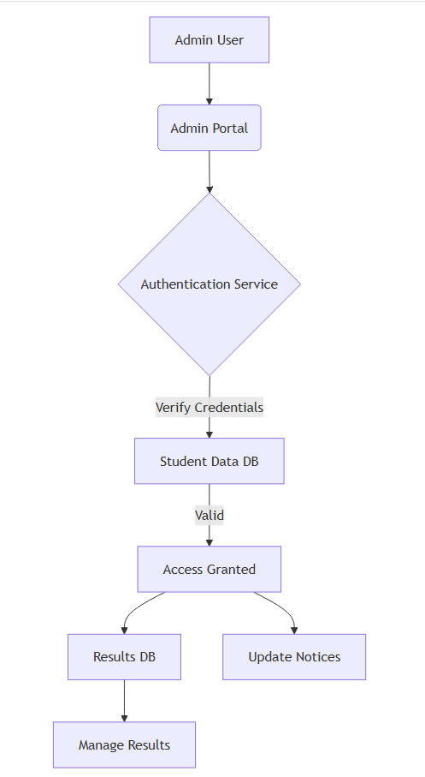
MODULE 2: DFD

Slide 29
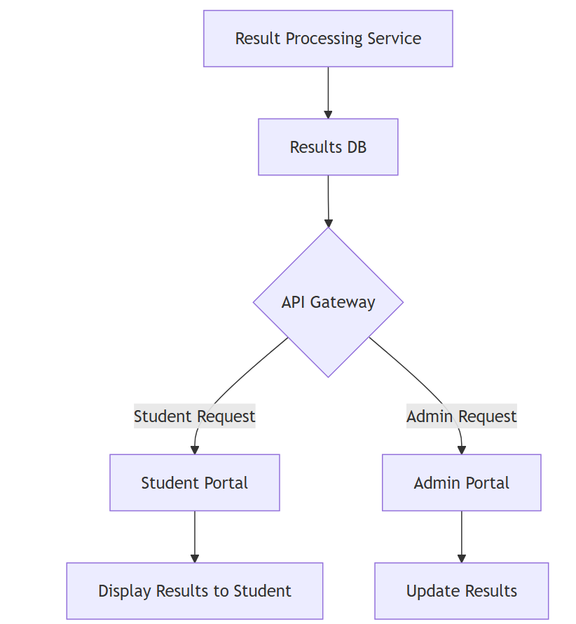
MODULE 3: DFD

Slide 30
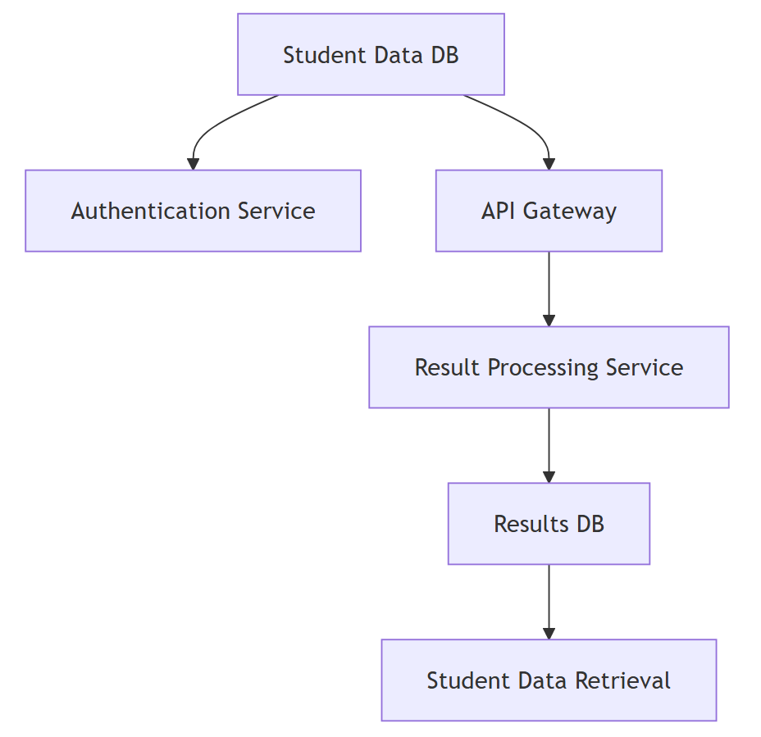
MODULE 4: DFD

Slide 31
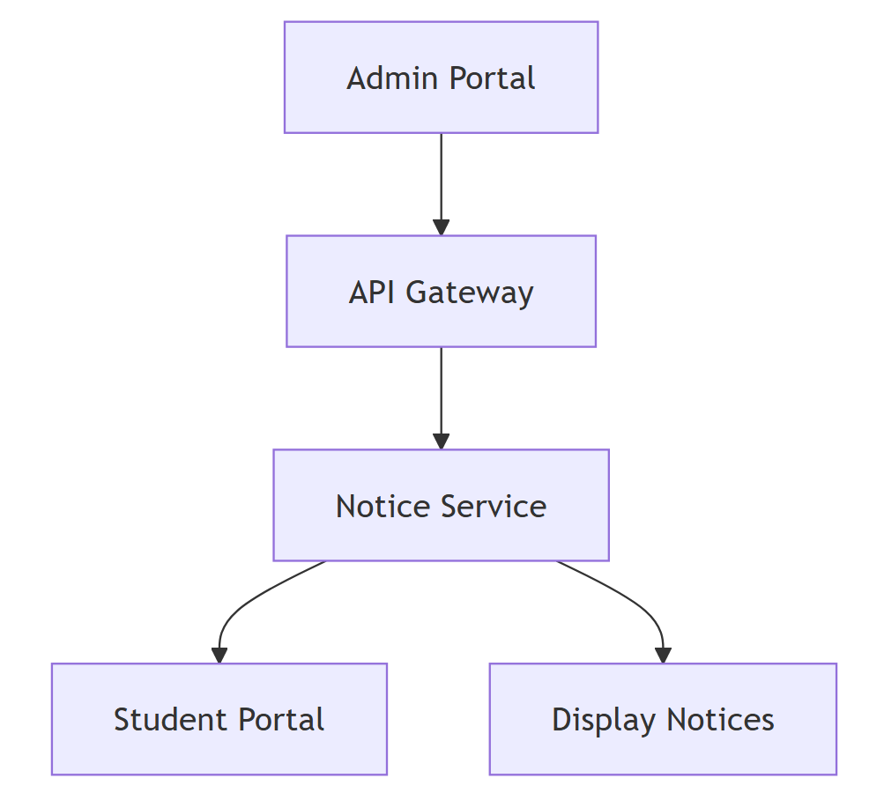
MODULE 5: DFD

Slide 32
FUNCTIONAL AND NON FUNCTIONAL REQUIREMENTS
FUNCTIONAL
User Authentication: The system must allow students, teachers, and administrators to log in using secure credentials.
Result Entry: Teachers must be able to input and update student grades for various assessments.
Grade Calculation: The system must calculate final grades automatically based on predefined weightages.
Result Access: Students must be able to view and download their results in real-time.
Data Management: The system must allow administrators to manage student, teacher, and course data efficiently.
Error Handling: The system must validate user inputs, flag inconsistencies, and provide meaningful error messages.
NON-FUNCTIONAL
Performance: The system must handle simultaneous logins and requests from multiple users without significant delays.
Scalability: The system must accommodate increasing numbers of users, courses, and data without performance degradation.
Security: All data must be stored securely using encryption, and the system must protect against unauthorized access.
Usability: The interface must be intuitive and user-friendly for students, teachers, and administrators.
Accessibility: The system must be accessible from any device with a browser, ensuring compatibility with desktops, tablets, and mobile devices.

Slide 33
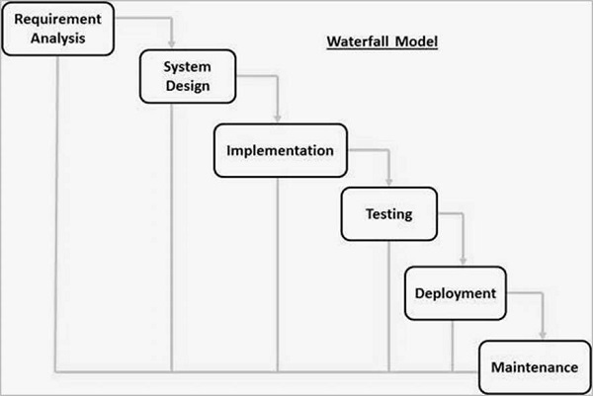
WATERFALL MODEL
The Waterfall Model is a linear software development methodology where each phase, such as requirements, design, implementation, testing, and maintenance, is completed sequentially before moving to the next. It is well-suited for projects with well-defined requirements and minimal changes expected during development. The model emphasizes a structured approach, ensuring each stage is thoroughly reviewed before progression.
Clear Requirements: The objectives and functionalities, such as result calculation, secure data storage, and report generation, are well-defined from the outset, making the sequential approach feasible.
Minimal Scope for Changes: The system's requirements are unlikely to change significantly during development, as they align with established institutional processes.
Phase Dependency: Each phase, from requirement gathering to final implementation, depends on the successful completion of the previous one, ensuring a systematic and error-free development process

Slide 34
THANK YOU

